Slide 1


Chintan parmar graphic & ui/ux designer
A study of
typography anatomy
Presented by
curvepixel.cp@gmail.com
+91 98243 51394

Slide 2
Defination
Typography is the art and technique of arranging type to make written language legible, readable, and aesthetically pleasing.
Typography plays a crucial role in enhancing the visual appeal of a design, making it more attractive, sophisticated, and professional.

Slide 3
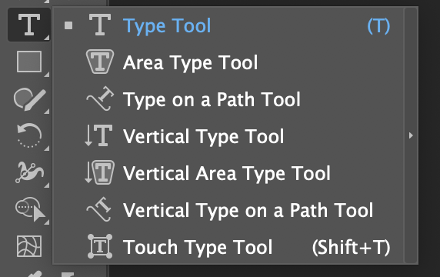
Tool use for typing Shortcut: T

Slide 4
Classification of type
Ag
serif
A serif is a stroke added to the beginning or end of one of the main strokes of a letter.
Ag
Sans Serif
A typeface without serifs is called a sans serif typeface, from the French word “sans” that means "without."
Ag
Monospace
A typeface that displays all characters with the same width is known as Monospace.
Ag
Script
Script typefaces have a natural, handwritten feel. Scripts can be classified as Black Letter, Calligraphic and Handwriting.
Ag
Display typefaces, also known as decorative, are a broad category of typefaces that do not fit into the preceding classifications. They are typically suited for large point sizes and primarily used for display.
Display (Decorative)

Slide 5
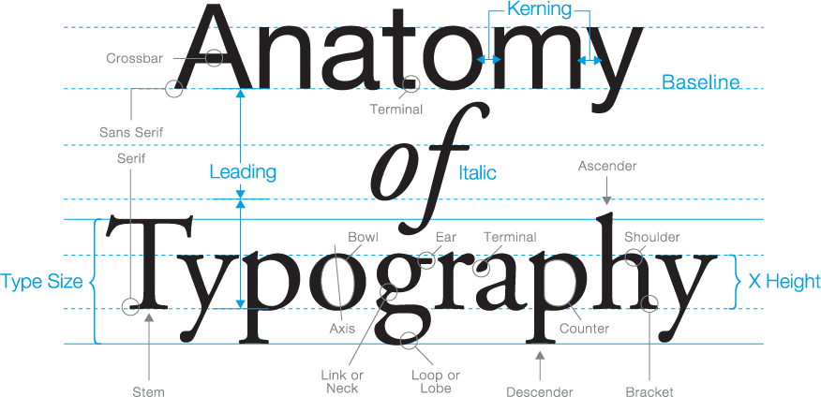
Anatomy of Typography

Slide 6
Ascender: An upward vertical stroke that extends beyond the x-height.
Descender: A downward vertical stroke that extends beyond the baseline.
Baseline: The invisible line in which all letters rest.
Cross bar: The horizontal stroke in letters. A, H, e, f
Kerning: The process of adjusting the spacing between individual letters or characters. For instance, an 'r' and 'n' spaced too closely can look like an 'm. ' Hence, a word like 'burn' can awkwardly read as 'bum.
x-height: The distance between the baseline and the height of the lowercase letter x.
Stem: The main vertical stroke in upright characters.
Shoulder: A curved stroke originating from a stem.
Terminal: A circular form at theend of the arm, leg, or brow.
Counter: Enclosed space in letters like o, b, d, and a.

Slide 7
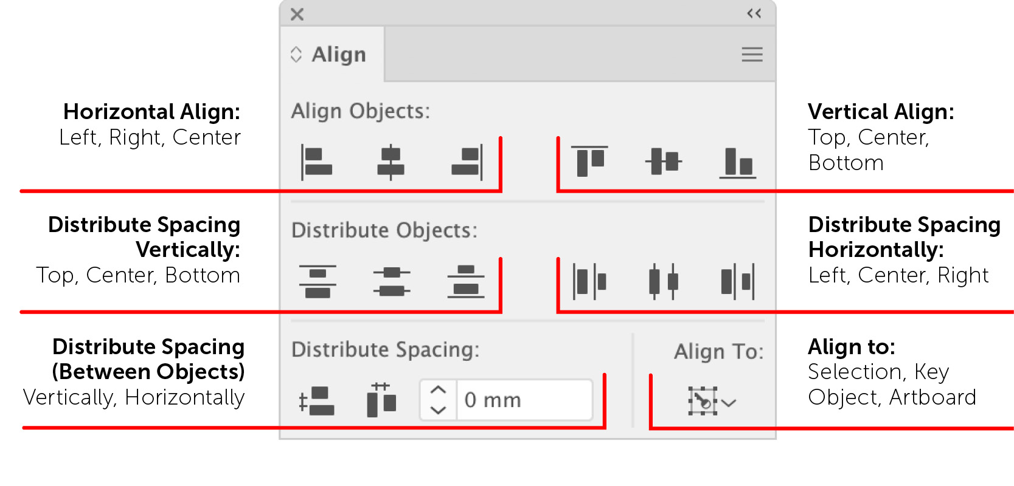
Type alignment
Type alignment controls how text aligns in the space it appears.

Slide 8
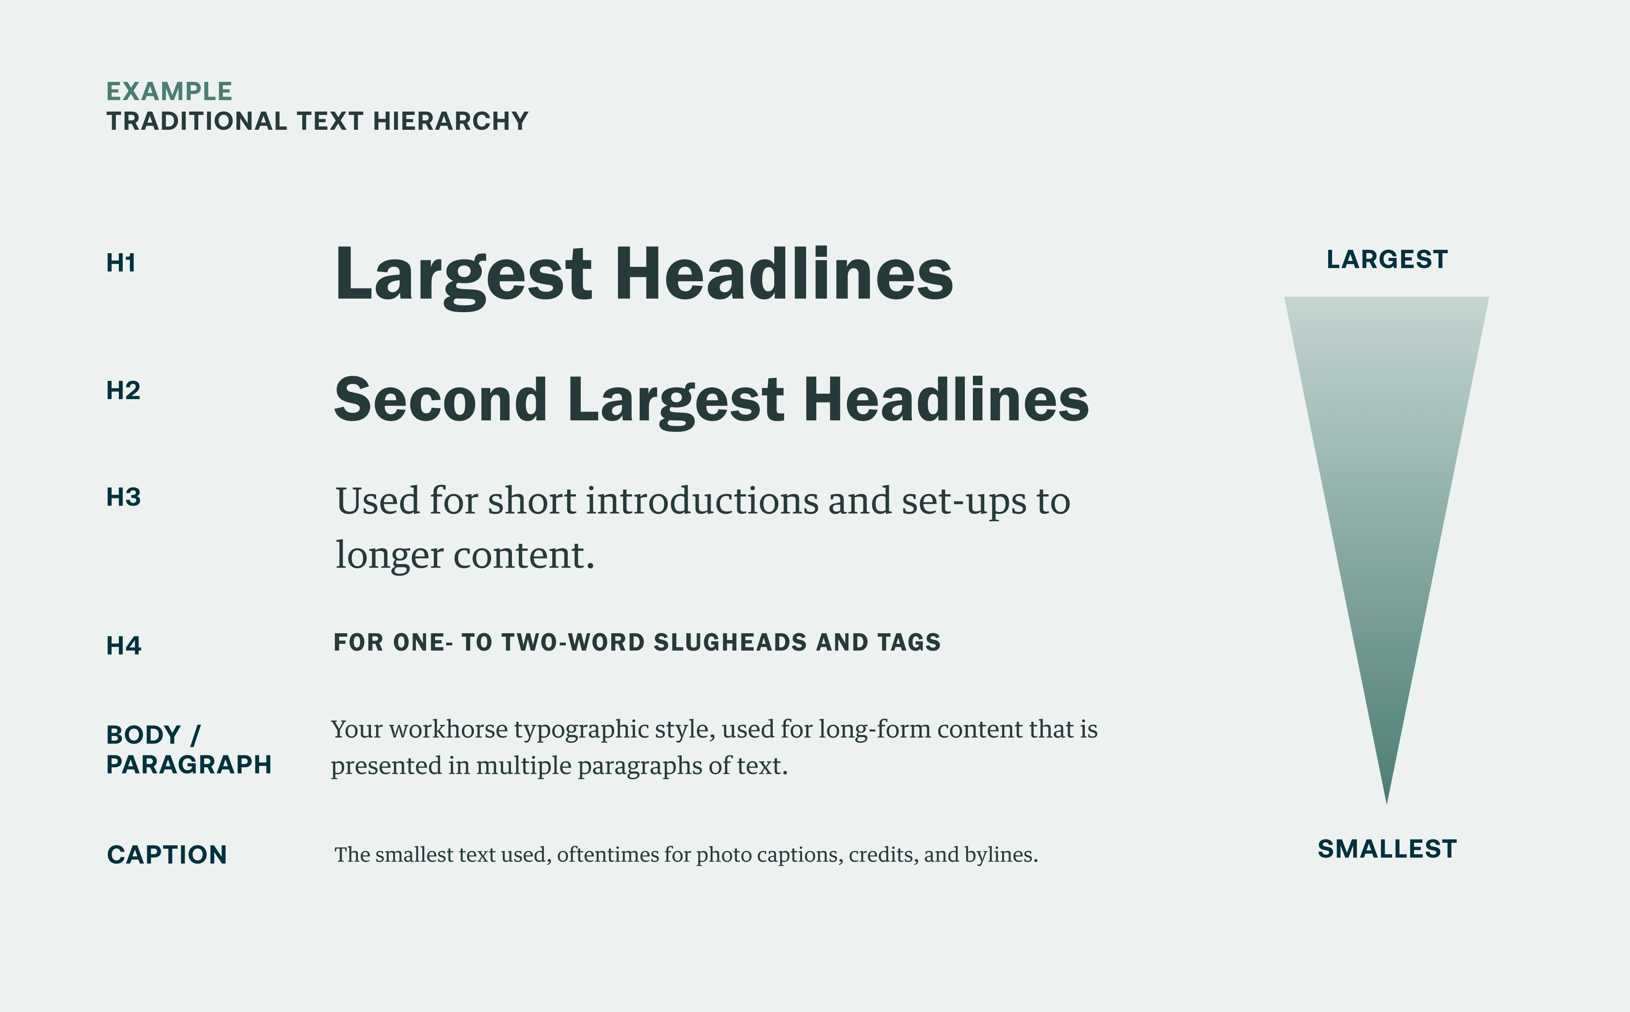

Slide 9
refferences
https://m2.material.io/design/typography/understanding-typography.html#type-classification
https://www.interaction-design.org/literature/article/what-is-type
https://m2.material.io/design/typography/understanding-typography.html#type-classification
https://noranadira.wordpress.com/week-3-anatomy-of-typography/
https://visme.co/blog/type-anatomy/
https://smithandconnors.com/insights/rethinking-text-hierarchy-web-accessibility

Slide 10
Any Questions?

Slide 11
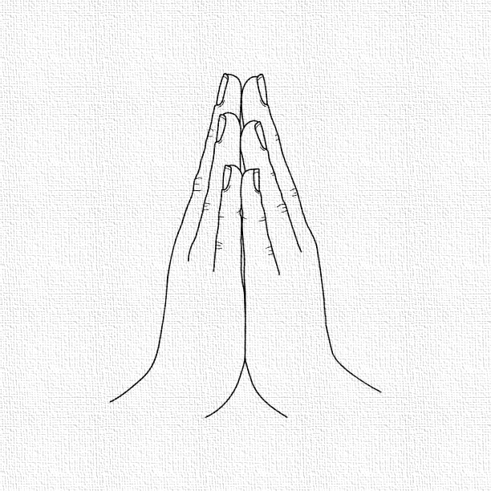
THANK YOU

